Slide 1
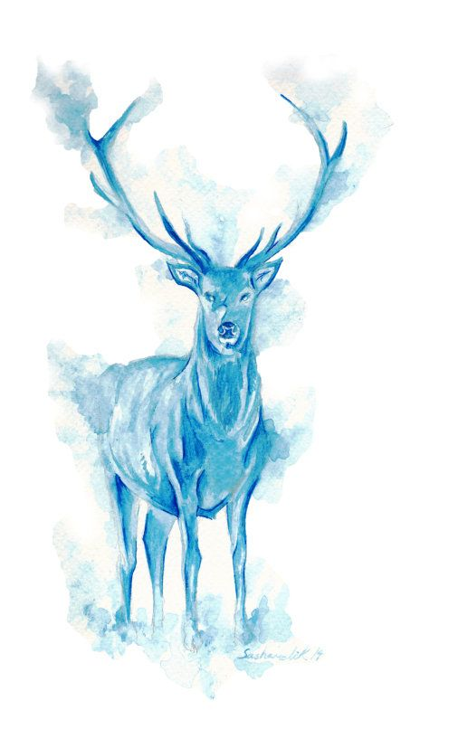
TEAM SNAPE

Slide 2
Helen Dun Consulting Group
Brief strategy about the framework being used.
Helen Dun Consulting Group prides itself on its thorough research and analysis of its clients problems. We believe every problem is unique as is the client. While we are experts in data analysis and solving problems it presents, our true specialty lies in seeing what data hides.
Knowing the measures PrimaPlanta takes to ensure consistency in quality, demand-study, marketing approach, and appeal to the youth, working with them is always expected to be a learning opportunity.
PrimaPlanta’s ambitions to expand into a new market shall also need a guiding hand, so that it does not fall into the quicksand of market entry. Our purpose shall be to highlight problems that PrimaPlanta may face and also provide solutions that give PrimaPlanta an edge over its competitors.

Slide 3
Question 1
PRICE | C1 (in Crores) | C2 (in Crores) | C3 (in Crores) | C4 (in Crores) | Net Revenue lost by Competitors (in crores)
₹ 24.00 | 20 | 16 | 8 | 4 | 48
₹ 20.00 | 7.5 | 12.5 | 5 | 0 | 25
₹ 26.00 | 3 | 1.5 | 0.3 | 0 | 4.8
₹ 30.00 | 3 | 10 | 4 | 1 | 18
The optimal price to sell PrimaPlanta is Rs. 24
This price draws off the maximum revenue from PrimaP’s competitors.
Question 2.1
Total Revenue for product PQR = Rs. 100 Cr
Rank | Company | Revenue % | Revenue (in Cr)
1 | C1 | 40 | 40
2 | C2 | 25 | 25
4 | C3 | 15 | 15
3 | C4 | 20 | 20
Ranking based on Revenue from product PQR alone.

Slide 4
Question 2.2
For product XYZ,
Company | Customers % | Customers (in crores)
c1 | 25 | 15
c2 | 20 | 12
c3 | 15 | 9
c4 | 10 | 6
PrimaP | 30 | 18
Company | Revenue/Customer | Net Revenue for XYZ(in crores)
c1 | ₹ 250.00 | ₹ 3,750.00
c2 | ₹ 150.00 | ₹ 1,800.00
c3 | ₹ 100.00 | ₹ 900.00
c4 | ₹ 200.00 | ₹ 1,200.00
PrimaP | ₹ 200.00 | ₹ 3,600.00
We already have data for no. of customers by brand for product XYZ.
Using that data we simply have to multiply it by revenue/customer to get the net revenue for product XYZ.
Rank | Company | Revenue (XYZ+PQR)
1 | c1 | ₹ 3,790.00
3 | c2 | ₹ 1,825.00
5 | c3 | ₹ 915.00
4 | c4 | ₹ 1,220.00
2 | PrimaP | ₹ 3,600.00
Ranking based on combined revenue from product XYZ and PQR

Slide 5
Question 3
We know that PrimaPlanta has 18 crore customers.
Assuming 30% of them buy product PQR and over the year buy an average of 4 products per customer.
We also know from question 1 that setting the price at Rs.24 gives us a market share of Rs. 48 crore and we also have to overcome fixed costs for break even point of Rs. 14 Crore
Products sold = customers * % of buyers of PQR * products/customer
= 180000000 * 0.3 * 4
= 216000000 ( 21.6 Crores)
Money to be obtained by revenue = Rs. (48+14) crores = Rs. 62 crores
Profit/unit = 62/21.6= Rs. 2.87

Slide 6
Question 4- Bydandruff
Income | Visits | No. of salespeople needed | Cost of hiring Salespeople | Profit
₹ 1,50,00,000.00 | 30000 | 50 | ₹ 1,80,00,000.00 | -₹ 30,00,000.00
₹ 4,80,00,000.00 | 60000 | 100 | ₹ 3,60,00,000.00 | ₹ 1,20,00,000.00
₹ 6,30,00,000.00 | 90000 | 150 | ₹ 5,40,00,000.00 | ₹ 90,00,000.00
₹ 7,20,00,000.00 | 120000 | 200 | ₹ 7,20,00,000.00 | ₹ 0.00
₹ 7,50,00,000.00 | 150000 | 250 | ₹ 9,00,00,000.00 | -₹ 1,50,00,000.00
₹ 7,60,00,000.00 | 180000 | 300 | ₹ 10,80,00,000.00 | -₹ 3,20,00,000.00
As seen in the above table, we can see that hiring 100 salespeople yields maximum profit. Hiring less and we go into loss and hiring more still increases cost while profit does not increase proportionately.

Slide 7
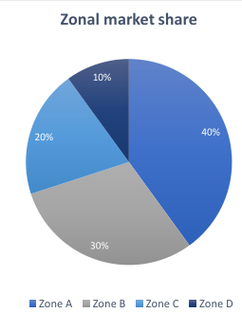
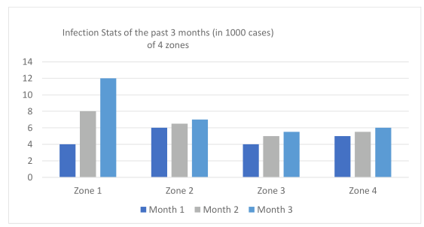
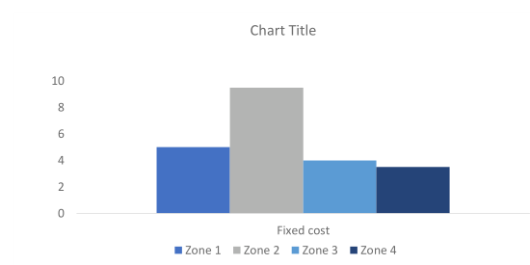
Question 5
Question 4- Bydandruff
Zones | Infection stats points | Market share points | Fixed Cost points | Points generated
Zone 1 | 1 | 4 | 2 | 7
Zone 2 | 2 | 3 | 1 | 6
Zone 3 | 4 | 2 | 3 | 9
Zone 4 | 3 | 1 | 4 | 8
*The best performer is allotted the max. points.
Zone 3 has accumulated the most points, hence it is the best possible target zone for the company to commence its operations from a financial standpoint.

Slide 8
Question 6
Plant | X-coordinate | Y-coordinate
P1 | 2.1 | 3.7
P2 | 1.2 | 7.4
P3 | 4.4 | 9
P4 | 5 | 5.9
P5 | 5.7 | 2.3
PLANT | TRANSPORTATION COST / unit /km
P1 | 0.2687
P2 | 0.2750
P3 | 0.2668
P4 | 0.3125
P5 | 0.2500
Market | X-coordinate | Y-coordinate
M1 | 2.7 | 2.1
M2 | 1 | 5
M3 | 2.2 | 8
M4 | 6 | 8
M5 | 6.8 | 4.2
Distances b/n market and Plants | P1 | P2 | P3 | P4 | P5
M1 | 1.71 | 5.51 | 7.11 | 4.44 | 3.01
M2 | 1.70 | 2.41 | 5.25 | 4.10 | 5.42
M3 | 4.30 | 1.17 | 2.42 | 3.50 | 6.69
M4 | 5.81 | 4.84 | 1.89 | 2.33 | 5.71
M5 | 4.73 | 6.45 | 5.37 | 2.48 | 2.20
Net Distance from all markets (in kms) | 5473.38 | 6110.95 | 6607.82 | 5053.10 | 6905.74
Net transportations costs/unit | ₹ 1,470.70 | ₹ 1,680.51 | ₹ 1,762.97 | ₹ 1,579.09 | ₹ 1,726.43

Slide 9
Question 6
Fixed Costs
Major Fixed Costs | P1 | P2 | P3 | P4 | P5
LAND | ₹ 28,00,00,000.00 | ₹ 27,00,00,000.00 | ₹ 27,00,00,000.00 | ₹ 28,00,00,000.00 | ₹ 25,00,00,000.00
ESTBLISHMEHT | ₹ 35,00,00,000.00 | ₹ 32,00,00,000.00 | ₹ 32,00,00,000.00 | ₹ 30,00,00,000.00 | ₹ 35,00,00,000.00
REVENUE | ₹ 42,00,00,000.00 | ₹ 42,00,00,000.00 | ₹ 40,00,00,000.00 | ₹ 38,00,00,000.00 | ₹ 40,00,00,000.00
MACHINERY | ₹ 35,00,00,000.00 | ₹ 36,00,00,000.00 | ₹ 37,00,00,000.00 | ₹ 38,00,00,000.00 | ₹ 35,00,00,000.00
DOCUMENTAT ON | ₹ 22,00,00,000.00 | ₹ 2,20,000.00 | ₹ 22,00,00,000.00 | 20.00.00.000 | ₹ 20,00,00,000.00
PLANNING | ₹ 15,00,00,000.00 | ₹ 16,00,00,000.00 | ₹ 15,00,00,000.00 | ₹ 15,00,00,000.00 | ₹ 15,00,00,000.00
Total Fixed Cost | ₹ 1,77,00,00,000.00 | ₹ 1,53,02,20,000.00 | ₹ 1,73,00,00,000.00 | ₹ 1,49,00,00,000.00 | ₹ 1,70,00,00,000.00
Variable Costs
Variable costs/unit | P1 | P2 | P3 | P4 | P5
LABOUR | ₹ 620.00 | ₹ 620.00 | ₹ 580.00 | ₹ 600.00 | ₹ 600.00
POWER | ₹ 625.00 | ₹ 600.00 | ₹ 600.00 | ₹ 600.00 | ₹ 600.00
RAW MATERIAL | ₹ 590.00 | ₹ 600.00 | ₹ 580.00 | ₹ 610.00 | ₹ 600.00
EMISSION | ₹ 170.00 | ₹ 180.00 | ₹ 165.00 | ₹ 185.00 | ₹ 165.00
TEMP MACHIN | ₹ 240.00 | ₹ 230.00 | ₹ 280.00 | ₹ 280.00 | ₹ 250.00
Net variable costs/unit | ₹ 2,245.00 | ₹ 2,230.00 | ₹ 2,205.00 | ₹ 2,275.00 | ₹ 2,215.00

Slide 10
CONCLUSION TO Q6
Net transportations costs/unit | ₹ 1,470.70 | ₹ 1,680.51 | ₹ 1,762.97 | ₹ 1,579.09 | ₹ 1,726.43
Net variable costs/unit | ₹ 2,245.00 | ₹ 2,230.00 | ₹ 2,205.00 | ₹ 2,275.00 | ₹ 2,215.00
Transportation+ Variable costs | ₹ 3,715.70 | ₹ 3,910.51 | ₹ 3,967.97 | ₹ 3,854.09 | ₹ 3,941.43
 | P1 | P2 | P3 | P4 | P5
For, 1 million units Transportation+ Variable costs | ₹ 3,71,56,96,645.59 | ₹ 3,91,05,12,285.42 | ₹ 3,96,79,66,296.09 | ₹ 3,85,40,94,138.76 | ₹ 3,94,14,34,531.69
Net total cost | ₹ 5,48,56,96,645.59 | ₹ 5,44,07,32,285.42 | ₹ 5,69,79,66,296.09 | ₹ 5,34,40,94,138.76 | ₹ 5,64,14,34,531.69
For, 1 lakh units
Transportation+ Variable costs | ₹ 37,15,69,664.56 | ₹ 39,10,51,228.54 | ₹ 39,67,96,629.61 | ₹ 38,54,09,413.88 | ₹ 39,41,43,453.17
Net Total Cost | ₹ 2,14,15,69,664.56 | ₹ 1,92,12,71,228.54 | ₹ 2,12,67,96,629.61 | ₹ 1,87,54,09,413.88 | ₹ 2,09,41,43,453.17
For, 10k units
Transportation+ Variable costs | ₹ 3,71,56,966.46 | ₹ 3,91,05,122.85 | ₹ 3,96,79,662.96 | ₹ 3,85,40,941.39 | ₹ 3,94,14,345.32
Net Total Cost | ₹ 1,80,71,56,966.46 | ₹ 1,56,93,25,122.85 | ₹ 1,76,96,79,662.96 | ₹ 1,52,85,40,941.39 | ₹ 1,73,94,14,345.32
For, 10mn units
Transportation+ Variable costs | ₹ 37,15,69,66,455.91 | ₹ 39,10,51,22,854.23 | ₹ 39,67,96,62,960.88 | ₹ 38,54,09,41,387.61 | ₹ 39,41,43,45,316.93
Net Total Cost | ₹ 38,92,69,66,455.91 | ₹ 40,63,53,42,854.23 | ₹ 41,40,96,62,960.88 | ₹ 40,03,09,41,387.61 | ₹ 41,11,43,45,316.93
We can draw the conclusion that for units less than 10 million P4 is the preferable plant, but if unit productions exceed 10 million , plant P1 is favorable.
This difference is mainly caused by relatively transportation and variable costs per unit of plant P4, which becomes the dominating factor when more units are produced.

Slide 11
DASHBOARD (SALES DATA)
*Double click below on sheet to activate

Slide 12
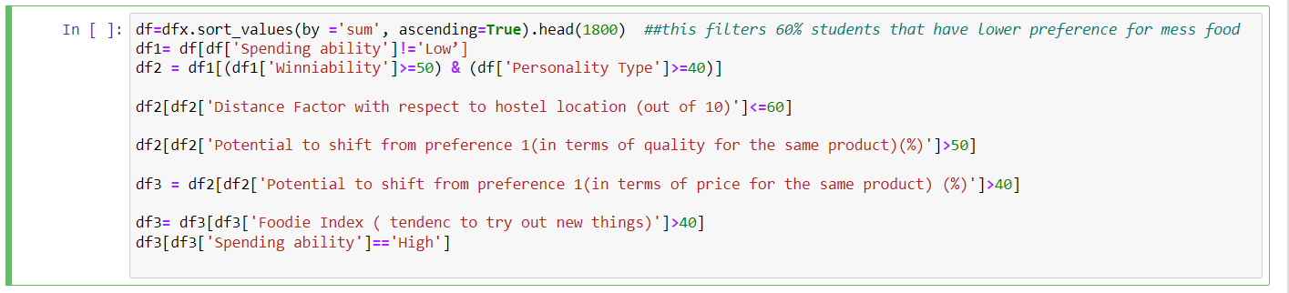
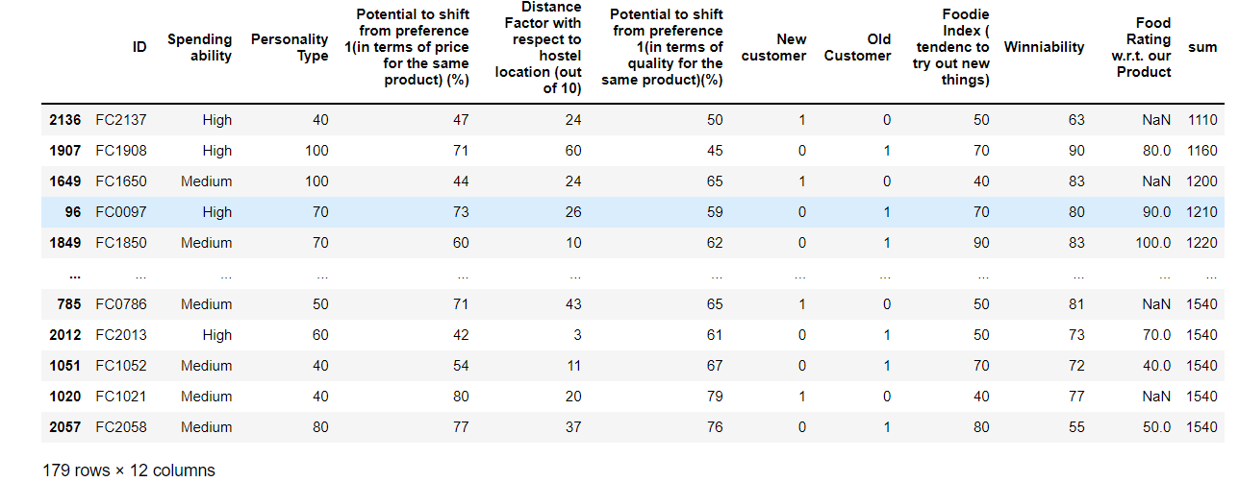
NIT Jamshedpur Customer Segment
Pandas has been used in this question to filter data and create a final sorted table
Code
Final Table

Slide 13
Guesstimate Flowchart
Total Students =3000
40% weightage removed for mess
number of students left=1800
No of people with spending High and Medium Spending ability = 1248
Students with winability >=50 and personality >=40
=568
Filtering with Distance Factor < = 60
students left=319
Students with potential to shift according to price >40 and quality >30
=179
Out of 179 , students with high spendabilty=85 and
medium spendabilty=94
Average net spend by High spend ability student is estimated to be Rs.100/day
Average net spend by Medium spend ability student is estimated to be Rs.70/day
Total Cashflow in a single day = 85*100 + 94*70
= Rs 15,080

